Slide 1

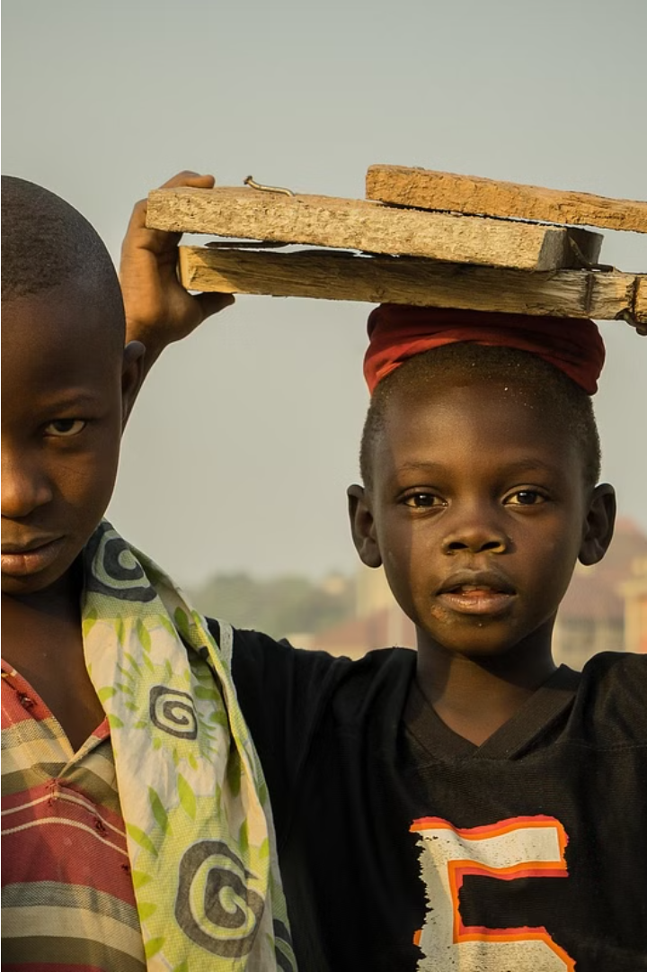

Overview of Child Labor and Protection in Nigeria

Slide 2
Lessons for today
Prevalence of Child Labor
Causes of Child Labor
Impact on Children's Well-being
Legal Framework and Government Efforts
Role of Civil Society
Challenges to Effective Protection
Recommendations for Improvement
Overview of Child Labor and Protection in Nigeria
Roadmap to Child Development and Needs
Understanding Child Development Stages
Physical Needs of Children
Emotional and Social Needs of Children
Cognitive and Language Development
Importance of Play and Exploration
Protecting Children's Rights and Wellbeing

Slide 3
“African children have the worst life chances in the world. And the gab between the survival rates, the education and the development of Africa's children and the children of other continents is increasing”.
Source-Salim Ahmed Salim- Former Secretary General of the African Union

Slide 4
Who is a CHILD?
International conventions define International conventions define children as age 18 and under is a child. But individual governments may define ”child” according to different ages or other criteria.

Slide 5
Nigeria faces the challenge of tackling child labor, where many young children are engaged in hazardous work, depriving them of their basic rights and opportunities.
In this lecture, we will learn how to
Ensure the protection and well-being of these vulnerable children and why it is crucial for Nigeria's development.
Explore the crucial stages of child development, from infancy to adolescence, and
understand the multifaceted needs that support healthy growth and well-being.
Discover how nurturing environments, attentive care, and respect for children's rights can empower them to thrive.

Slide 6
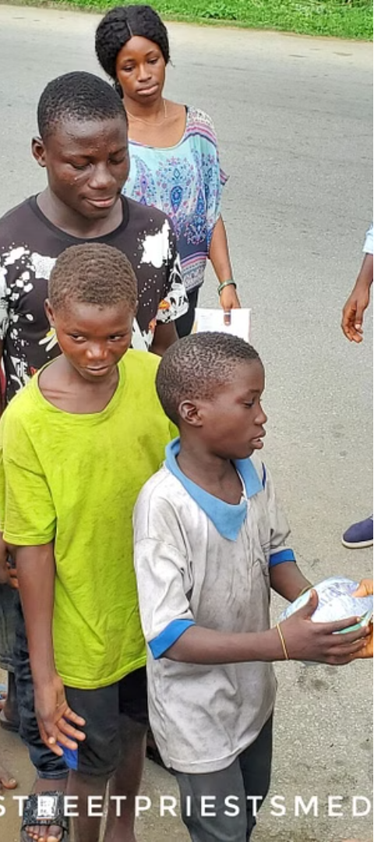
Prevalence of Child Labor
1
High Rates
2
Vulnerable Groups
Nigeria has one of the highest rates of child labor in the world, with millions of children engaged in various forms of work, often in dangerous conditions.
The problem is particularly prevalent among economically disadvantaged families, with children from rural areas and impoverished urban communities being the most affected.
3
Informal Sector
A significant portion of child labor in Nigeria occurs in the informal sector, such as street vending, domestic work, and agriculture, making it difficult to monitor and address.

Slide 9
Note: (a) ILO, Guidelines concerning the measurement of forced labour, 20th International Conference of Labour Statisticians, Geneva, 2018, ICLS/20/2018/Guidelines.
Source: Ministry of Labour and Employment and ILO compilation.

Slide 10
Causes of Child Labor
Poverty
Lack of Access to Education
Cultural Norms
Poverty is a major driver of child labor, as families may rely on the income generated by their children to meet basic needs.
In some communities, there is a prevailing cultural acceptance of children working, often as a means of learning or contributing to the family's livelihood.
Limited availability and affordability of quality education, especially in rural areas, force many children to work instead of attending school.

Slide 11
Impact on Children's Well-being
Health Risks
Interrupted Education
Child laborers are often exposed to hazardous working conditions, leading to physical injuries, long-term health problems, and even death.
The demands of work often prevent children from attending school regularly, hindering their educational development and future opportunities.
Psychological Trauma
Exploitation and Abuse
The exploitation and abuse experienced by child laborers can have severe psychological consequences, including trauma, depression, and anxiety.
Many child laborers face exploitation, violence, and various forms of abuse, further exacerbating the negative impact on their well-being.

Slide 12
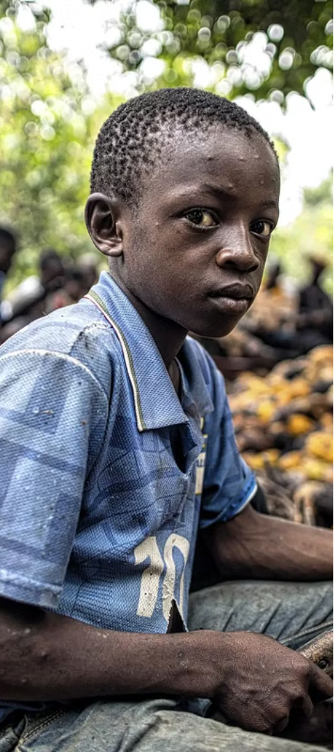



Legal Framework and Government Efforts
Legislation
Nigeria has enacted laws to prohibit child labor and protect the rights of children, such as the Child Rights Act and the Labor Act.
Enforcement Challenges
However, the effective implementation and enforcement of these laws remain a significant challenge, with limited resources and capacity.
Government Initiatives
The government has launched various programs and interventions to address child labor, including awareness campaigns, social protection schemes, and strengthening of child protection systems.

Slide 13




Role of Civil Society
Advocacy
Awareness Raising
Community Engagement
Service Provision
Civil society organizations play a crucial role in advocating for stronger child protection policies and their effective implementation.
Many organizations offer direct services, such as education, skills training, and rehabilitation programs, to support and empower former child laborers.
These organizations work to raise public awareness about the issue of child labor and the importance of child protection.
Civil society groups collaborate with local communities to identify and address the root causes of child labor, providing support and resources.

Slide 14

Challenges to Effective Protection
1
Weak Enforcement
The limited capacity and resources of enforcement agencies hinder the effective implementation of child labor laws and policies.
2
Socioeconomic Factors
Poverty, lack of access to education, and cultural norms continue to drive families to engage their children in labor, despite legal prohibitions.
3
Informal Sector Challenges
The prevalence of child labor in the informal sector, such as domestic work and agriculture, makes it difficult to monitor and address the issue.

Slide 15

Roadmap to Child Development and Needs

Slide 16

Understanding Child Development Stages
1
Early Childhood (0-5 years)
2
Middle Childhood (6-10 years)
Rapid physical growth, language development, social-emotional skills, and cognitive milestones during this foundational period.
Focus on gaining independence, improving motor skills, expanding academic abilities, and navigating social relationships.
3
Adolescence (11-18 years)
Identity formation, increased emotional changes, sexual maturation, cognitive complexity, and preparing for adulthood.

Slide 17

Physical Needs of Children
Children have fundamental physical needs that must be met for healthy growth and development. These include adequate nutrition, clean water, shelter, rest, and physical activity.
Proper nutrition provides the energy, vitamins, and minerals essential for children to thrive. Sufficient sleep allows their bodies and minds to recharge and recover.
Regular physical activity supports muscle development, coordination, and cardiovascular health. Meeting these basic physical needs is crucial for children to reach their full potential.

Slide 18
Emotional and Social Needs of Children
Attachment and Belonging
Self-Esteem and Confidence
Children need strong emotional bonds with caregivers to feel secure and loved. Positive relationships help them develop a sense of belonging and trust.
Encouragement, praise, and acceptance from loved ones foster a child's self-esteem and confidence. This supports healthy social-emotional development.
Emotional Expression
Social Skills
Allowing children to express their feelings in a safe environment helps them learn to identify and manage emotions. This builds emotional intelligence.
Opportunities for play and interaction teach children cooperation, communication, and other vital social skills needed to form healthy relationships.

Slide 19
Cognitive and Language Development
Cognitive Growth
Language Milestones
Importance of Interaction
Supporting Bilingualism
Children's cognitive abilities develop rapidly in the early years, enabling them to problem-solve, think logically, and understand abstract concepts. This lays the foundation for future academic success.
Infants begin cooing and babbling, then progress to first words and two-word phrases. Toddlers rapidly expand their vocabularies and learn to communicate their needs and ideas effectively.
Engaging children in conversations, reading aloud, and encouraging questions are crucial for optimal language development. This nurtures their curiosity and helps them make sense of the world around them.
Children who grow up in bilingual environments have unique cognitive advantages, such as enhanced problem-solving skills and greater mental flexibility. Exposing them to multiple languages early on supports their overall development.

Slide 20

Importance of Play and Exploration
Play is essential for a child's healthy development. Through play, children explore their world, stimulate their senses, and cultivate important cognitive, social, and emotional skills. Unstructured, imaginative play fosters creativity, problem-solving, and a joy of learning.
Providing opportunities for exploration allows children to satisfy their innate curiosity, develop fine and gross motor abilities, and deepen their understanding of the world around them. Playful learning nurtures a child's overall well-being and sets the foundation for lifelong success.

Slide 21



Promoting Healthy Attachment and Bonding
Nurturing Connection
Responsive Care
Open Communication
Fostering strong emotional bonds and secure attachments between children and their caregivers is crucial for healthy development.
Attentive, responsive, and consistent caregiving supports the formation of trust, empathy, and a sense of safety.
Encouraging open communication, active listening, and expressing emotions in a healthy way strengthens parent-child relationships.

Slide 22



Protecting Children's Rights and Wellbeing
Upholding Children's Rights
Supporting Child Wellbeing
Creating Safe Environments
Ensure all children have access to their fundamental rights, including the right to education, healthcare, protection from abuse, and opportunities to thrive.
Prioritize the physical, emotional, and mental wellbeing of children through trauma-informed care, family support, and community-based resources.
Establish safe, nurturing environments where children can learn, explore, and develop without fear of harm or exploitation.

Slide 23



Supporting Children with Special Needs
Inclusive Environments
Tailored Supports
Family Involvement
Ensuring accessible, inclusive, and supportive environments for children with special needs is crucial to their development and wellbeing.
Providing specialized educational supports, therapies, and accommodations based on each child's unique needs and abilities.
Actively involving and supporting families in the care and education of children with special needs.

Slide 24

Conclusion and Key Takeaways
In conclusion, this presentation has explored child labor and protection in Nigeria, the critical aspects of child development and the diverse needs that children have for healthy growth and well-being.
By understanding the stages of physical, emotional, social, and cognitive development, we can better support children and ensure their rights are protected.

Slide 25

END
THANK YOU
This material and other viable materials for self-improvement are available at
https://www.positivepsychology.org.ng/

